Slide 1

BIE
Spring 2026
ELA/Mathematics
Report Training
Spring Summative Assessment
September 4, 2026

Slide 2
Welcome
Presented by the BIE CAO Assessment Team with Pearson.
On behalf of the BIE CAO Assessment Team,
Welcome to the BIE Spring 2026 ELA/Mathematics Reports Training.
We’re glad you’re here, and we appreciate you taking the time to join us today.
Pearson Representatives
BIE Representative
Christine Nelson Senior Project Manager
Jessica Spanier Program Manager
Anna Patro Project Manager
Dr. Tim O’Neil Psychometrician
Aurelia Shorty
Dr. Carmelia Becenti
Dr. Douglas Clauschee
Mr. Donald Griffin

Slide 3
Webinar Norms
Introduce yourself
✓
Please type the following in the chat box: name, e-mail, role, and school.
Keep the line clear
✓
Please be sure to mute your microphone. Questions should be posted in the Q&A.
Materials to follow
✓
Today’s training will be recorded and posted along with this PPT presentation.
The recording and presentation will be available at https://bie.mypearsonsupport.com/
Resources will be posted on the BIE support site at the conclusion of the training.

Slide 4
Agenda
1
Welcome and webinar norms
5
Reading the School Proficiency Summary
2
2026 summative assessment overview
6
Interpreting and communicating results
3
Printed reports: what schools receive
7
Accessing reports in ADAM
4
Reading the Individual Student Report
8
Questions, support, and resources

Slide 5
2026 Summative Assessment
1
2
3
New assessment
BIE ownership
Do not compare years
2026 is the first year for the new summative tests providing the base for new reporting scales.
BIE educators helped develop items, performance level descriptors, and cut scores.
Use 2026 as the baseline for tracking future progress rather than comparing with prior-year results. The 2026 summative reports differ from reports in previous years.
Protect results: individual student results are confidential.

Slide 6
New Assessment
What is Standard Setting?
Standard setting is the process used to determine the cut scores that separate assessment results into performance levels.
1
2
3
Educator panels review
Judgment meets data
Reviewed and approved
Panels of educators examine the standards, performance-level expectations, and the test questions themselves.
Using professional judgment, assessment data, and multiple rounds of review, panelists recommend the minimum score for each level.
Recommendations are reviewed across grades for consistency and then approved by BIE.

Slide 7
Who Set the Standards, and When
Educator panels met in July 2026 to recommend cut scores.
July 2026 meetings
Participation
BIE-selected educators reviewed standards and test items, defined borderline performance, and recommended cut scores.
Main panel meetings
July 6–9
Panelists by subject and grade
Grade 11 ELA and Algebra II panels
July 8–9
Subject | 3 | 4 | 5 | 6 | 7 | 8 | HS
ELA | 10 | 10 | 9 | 5 | 6 | 5 | 5
Math | 9 | 9 | 9 | 6 | 7 | 3 | 6
Vertical articulation sessions
July 10
HS = Grade 11 for ELA and Algebra II for mathematics.

Slide 8
How Cut Scores Were Set: Modified Angoff
A structured, item-by-item method for recommending each performance-level boundary.
1
Define the borderline student
Describe what a student just entering each performance level should know and be able to do.
2
Rate every test question
Estimate how likely that borderline student is to answer correctly at each performance level threshold, or how many points they would earn.
3
Repeat across rounds
Complete multiple rating rounds, reviewing group feedback and student impact data between rounds.
4
Recommend the cut scores
The panel’s median recommendation becomes the proposed score for each performance-level boundary.
In simple terms: Educators use expert judgment, item by item, to determine the minimum score students need to reach each performance level.

Slide 9
Two Panel Roles in Standard Setting
Grade-level panels recommend the cut scores; vertical articulation panels align them across grades.
Grade-level panelists
Focused on one grade or course
Vertical articulation panelists
A smaller subset of the grade-level committees
Reviewed test items and performance expectations for their assessment.
Completed three Modified Angoff judgment rounds.
Recommended the cut scores for that grade or course.
Compared recommendations and impact data across grades.
Recommended potential adjusted scores within reasonable ranges.
Reached consensus so expectations progress consistently grade to grade.
Together: summed item-level judgment sets each cut score, and cross-grade review keeps expectations coherent from grade 3 through high school.

Slide 10
Printed Reports
What each school receives in the print shipment
Sample reports are illustrative only and do not include any student data.

Slide 11
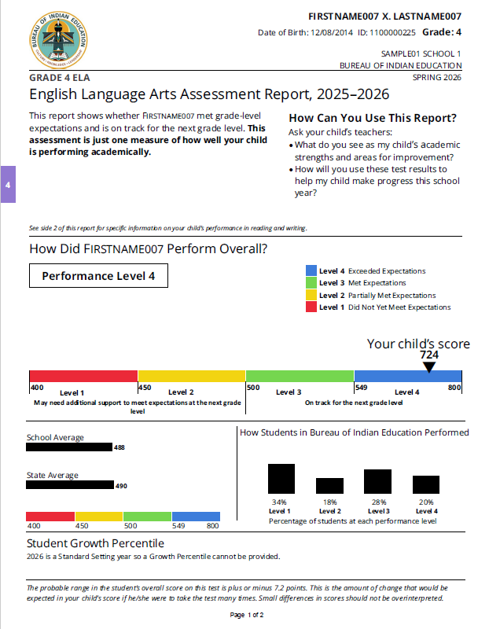
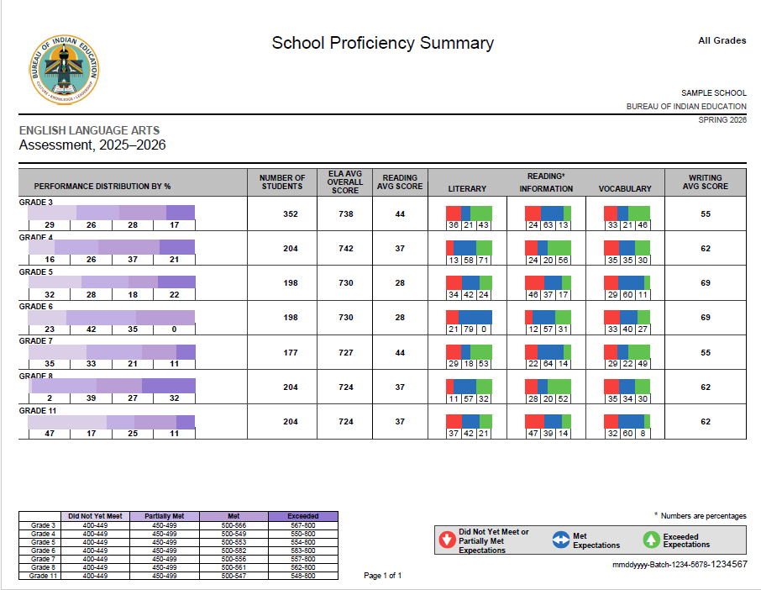
Printed Reports
What each school receives in the print shipment
Individual Student Report (ISR)
School Proficiency Summary
2 per student, per content area · 1 parent letter per student
2 summary reports per school
Reports delivered to schools by September 25, 2026

Slide 12
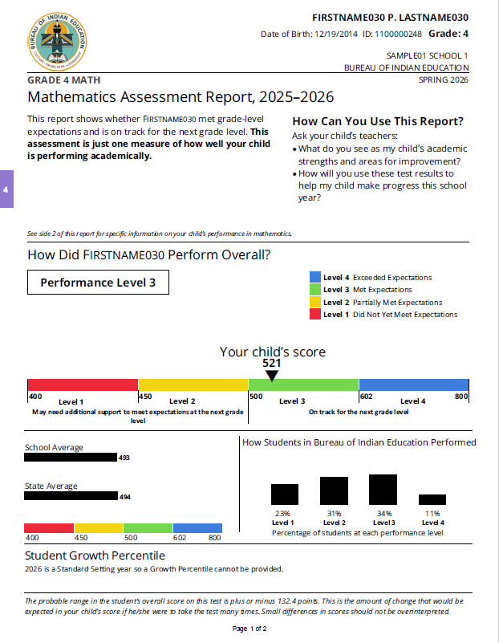
Individual Student Report (ISR) Page 1
Use the ISR to explain one student’s results
English Language Arts
Mathematics
Overall scale score
Performance level
School and BIE averages
BIE performance distribution
2026 Student Growth Percentiles are not reported because new cut scores were established in spring 2026.

Slide 13
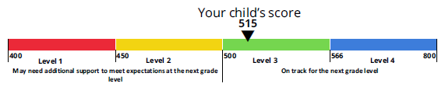
Read the overall result in two steps
1
View the scale score
2
Identify the performance level
Level 4
Exceeded Expectations
Level 3
Met Expectations
All tests use a 400–800 scale. Performance-level ranges vary by grade and subject.
Level 2
Partially Met Expectations
Level 1
Did Not Yet Meet Expectations

Slide 14
Scale score ranges
Levels 1 and 2 are 400–449 and 450–499 for every test.
The Level 3 and 4 range varies by grade and subject.
How to use the table
Grade / Course
ELA Level 3
ELA Level 4
Math Level 3
Math Level 4
Identify the test
1
3
500–565
566–800
500–551
552–800
Select the student’s subject and grade or course.
4
500–548
549–800
500–601
602–800
Find the score range
2
5
500–552
553–800
500–556
557–800
Locate the range containing the overall scale score.
6
500–581
582–800
500–598
599–800
Confirm the level
7
500–555
556–800
500–587
588–800
3
The range identifies Performance Level 1, 2, 3, or 4.
8
500–560
561–800
500–762
763–800
Do not use another grade or subject’s cut scores.
11 / Algebra II
500–546
547–800
500–616
617–800

Slide 15
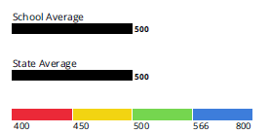
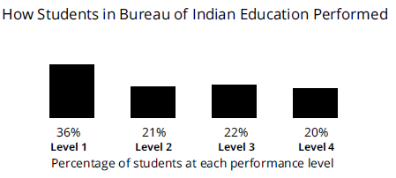
Context Beyond a Single Score
School and BIE averages
BIE performance distribution
Compare the student’s overall score with same-grade, same-subject averages.
Shows the percentage of BIE students at each performance level.

Slide 16
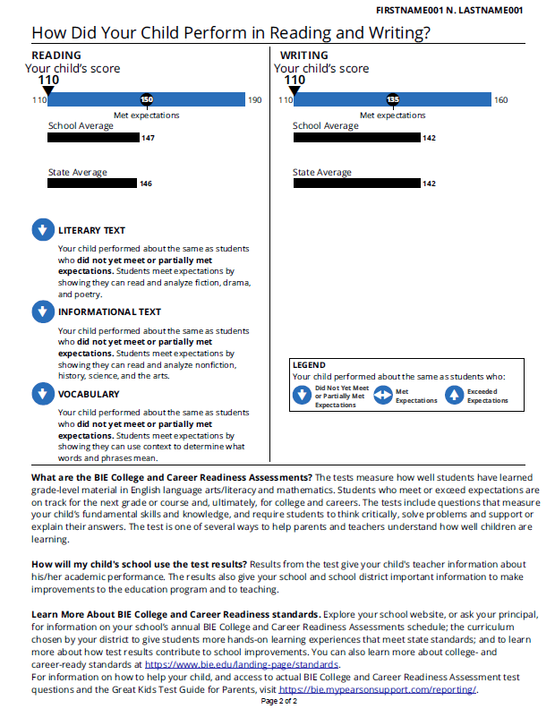
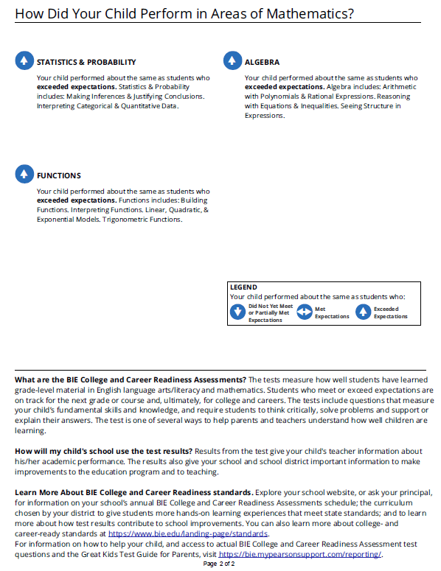
Individual Student Report (ISR) Page 2
Use page 2 to explain performance by content area
English Language Arts
Mathematics
ELA claims and subclaims
Mathematics domains
Performance for each area
Mathematics domains vary by grade.
Claim/subclaim/domain results show strengths and areas for improvement; they do not add up to the overall score.

Slide 17
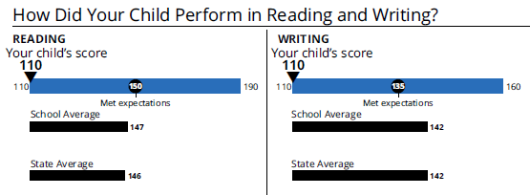
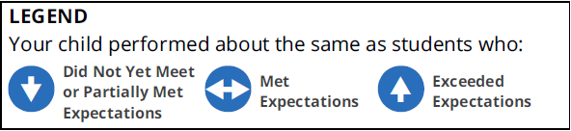
English Language Arts ISR Page 2
Reading and Writing are reported on their own scales
These scores do not add up to the overall scale score.
ELA reading subclaims
How to use the legend
Each icon compares your student with students who met expectations overall.
Use the subclaim icons to spot relative strengths and areas for improvement.
Subclaim results are directional signals, not separate scores.
Literary Text
Informational Text
Vocabulary

Slide 18
Mathematics ISR Page 2
Mathematics domains vary by grade
How to read the icons
Grade | Domains
Grades 3–4 | Operations & Algebraic Thinking; Number & Operations in Base Ten; Number & Operations–Fractions; Measurement & Data
Grade 5 | Number & Operations in Base Ten; Number & Operations–Fractions; Measurement & Data; Geometry
Grades 6–7 | Ratios & Proportional Relationships; The Number System; Expressions & Equations; Statistics & Probability
Grade 8 | Functions; Expressions & Equations; Geometry; Statistics & Probability
Algebra II | Statistics & Probability; Algebra; Functions
What the arrows mean
Each icon compares a student’s domain performance with students who met expectations overall.
Arrows point up, level, or down to show performance above, at, or below that comparison group.
How to use it
Domain results show patterns of strength and areas for improvement— they are not separate scores.
Look for domains where several students in a grade share the same pattern.

Slide 19
School Proficiency Summary: English Language Arts results by grade
Performance distribution by percentage
Number of students included
Average overall score
ELA Reading and Writing averages
ELA subclaims
Results by grade

Slide 20
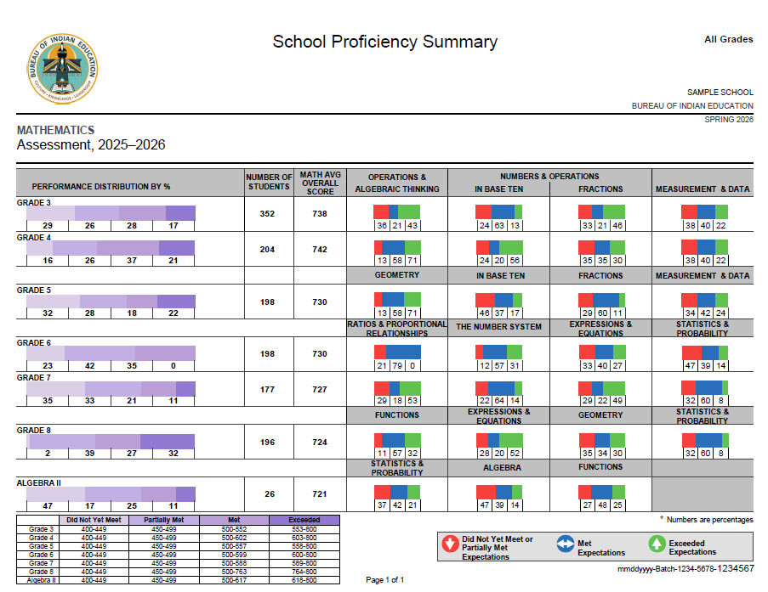
School Proficiency Summary: Mathematics results by grade
Performance distribution by percentage
Number of students included
Average overall score
Mathematics domain averages
Results by grade or course

Slide 21
Interpreting Results
Lead with context
Look at the overall result
Use detail carefully
2026 establishes a new baseline. Do not compare results with prior years.
Start with the overall scale score, then connect it to the performance level.
Claim, subclaim, and domain results add context but should not replace the overall result.
Protect privacy
Point to next steps
Protect student privacy and only share individual results with guardians as appropriate.
Use results with classroom evidence to support instructional planning.
FERPA

Slide 22
Accessing Reports in ADAM
Find, review, export, and download summative reporting results

Slide 23
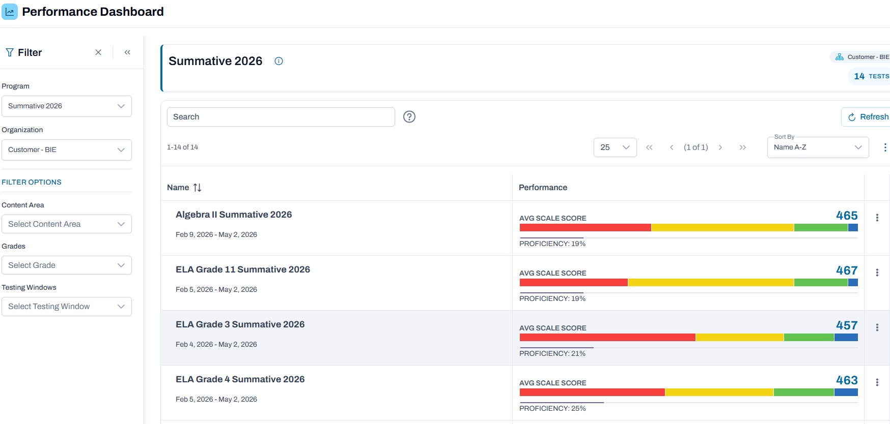
Performance Dashboard
Displays an overview of all assessments and updates dynamically during the testing window. Once administration ends, the data remains static.
What it shows
A high–level snapshot of assessment performance, with quick navigation into deeper reporting.
“How are my students performing, and where should I look closer?”
How to access
Go to Reporting → Performance
Filter by Program → Test
Click anywhere in a test row or the ellipsis

Slide 24
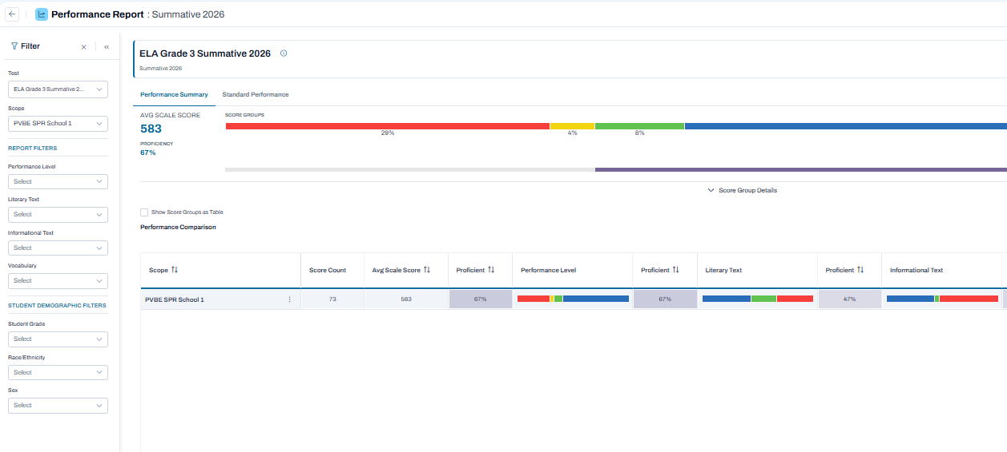
Performance Summary
What it shows
Use this to view school or organization performance overall. Users can only view the school(s) they are assigned to.
“How is our school or organization performing overall?”
Screenshot
How to access
Go to Reporting → Performance
Filter by Program → Test
Select the Performance Summary tab
To generate a CSV or Excel file, select the ellipsis → Export

Slide 25
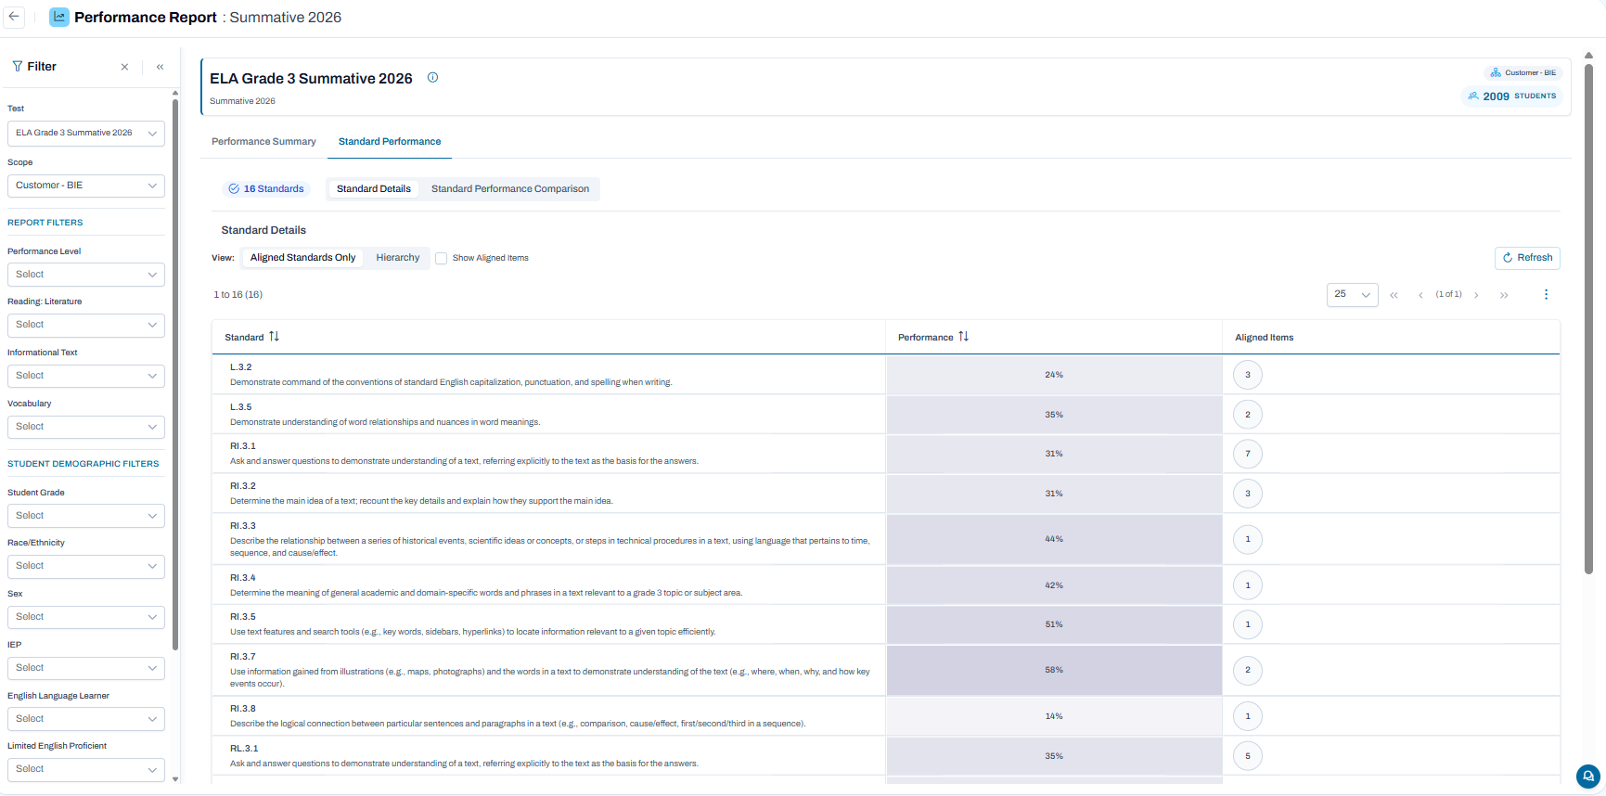
Standard Performance
What it shows
Use this to support instructional planning and to identify curriculum areas of focus.
“How well are students performing on each standard?”
How to access
Go to Reporting → Performance
Filter by Program → Test
Select the Standard Performance tab
Select Standard Details or Standard Performance Comparison
To generate a .csv or Excel file, select the ellipsis → Export

Slide 26
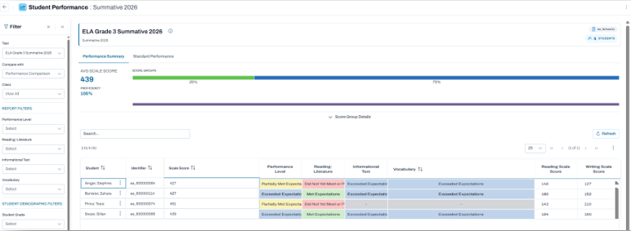

ISRs
What it shows
Use this to view student–level results.
“How did this specific student perform?”
How to access
Go to Reporting → Performance
Filter by Program → Test
Click the ellipses next to your school name → Student Performance to view individual students
Locate Student click ellipses → View ISR
To print ISRs follow the directions in the Report Assets section below
use the search icon to search by name or identifier to quickly view ISR

Slide 27
Report Assets
What it shows
Use this to download, review, print, and share school–level or student–level summative results.
“How can I access printable school summaries or individual student reports?”
How to access
School Proficiency Summary - filter on Report Type “ELA SPS-pdf” or “Mathematics SPS-pdf”.
Go to Reporting → Report Assets → Files
Search by school year and report type
Individual Student Report - choose the grade and content ISR from the drop-down list.

Slide 28
Questions & Answers
What are the ELA Claims and Subclaims?
ELA Claims include Reading and Writing, and the Reading subclaims are Literary Text, Information Text and Vocabulary.
Q
A
Will the assessment results be posted to students NASIS record?
Yes, BIE expects results to be available in NASIS in January 2027.
Q
A
Where do you find the reports that were exported?
Most exported reports go directly to your desktop downloads. For the Performance Comparison report, export report and then go to "Show History" to download.
Q
A
Q
Are there new testing blueprints and if so, where are they?
A
Go to https://bie.mypearsonsupport.com/
Administration Resources > Summative > Additional Resources
On ISR, School Average is our school and State Average is NM or just BIE/Grant schools?
The 'State Average' includes all schools under BIE regions (Bureau Operated Schools, Navajo Schools and Tribally Controlled Schools). It does not represent the state in which a school resides.
Q
A

Slide 29


Customer Support, Contacts & Resources
Go to https://bie.mypearsonsupport.com/
Administration Resources > Reporting
BIE Customer Support
BIE contacts
Key resources
Posted
1-833-302-9587
General ELA and Math
Assessment questions
Aurelia Shorty
Education Program Specialist
(Assessment & Accountability)
aurelia.shorty@bie.edu
1
BIE Summative Report Interpretation Guide.pdf
✓
Monday – Friday
(PT) 4:00 AM – 5:30 PM
(MT) 5:00 AM – 6:30 PM
(CT) 6:00 AM – 7:30 PM
(ET) 7:00 AM – 8:30 PM
2
BIE Summative Scale Score Ranges.pdf
✓
Assessment data files
Dr. Rebecca Izzo
Research Analyst
rebecca.izzo@bie.edu
3
BIE_Reporting_Summative_2026 ppt
9/9/26
4
BIE_Reporting_Summative_2026 ppt_pdf
9/9/26
Live chat
Assessment contract
BJ Howerton
Contracting Officer’s Representative
bj.howerton@bie.edu
5
BIE_Reporting_Summative_2026_recording
9/9/26
Select icon in ADAM
Select icon on bie.mypearsonsupport.com

Slide 30

Help Shape the Future of BIE Student Achievement!
Tell us if you are interested in participating in future BIE and Pearson assessment activities.
Who should complete it
How to sign up
Educators with experience implementing learning standards in:
1
Go to bie.mypearsonsupport.com
Subjects
English Language Arts Mathematics
Grade bands
Grades 3–8
High School
2
Open the Educator Interest Form.
3
Share your subject areas, grade bands, and region.
No prior assessment experience is required!
4
We will contact you as opportunities open.
Complete the BIE Educator Interest Form

Slide 31
Upcoming Training
Mark your calendar for the next session in the BIE assessment training series.
SESSION TIME
10:00 to 11:30 MT
11:00 to 12:30 CT
12:00 to 1:30 ET
Interim Pre-Admin Training
September 11, 2026
All test coordinators are encouraged to attend.
Be on the lookout for an invitation in your inbox.

Slide 32
BIE Office Hours
Thursdays, beginning September 17, 2026
Thank You
1:00 MT | 2:00 CT | 3:00 ET
Thank you for joining. Reach out to BIE or Pearson support with any questions.
Check the ADAM Bulletin Board for the meeting link.
Topics include Reporting, Navvy, Interim & Summative assessments.

